Slide 1
Programming 4 - Intermediate Architecture
and Algorithms
Prolog Basics
Semester 1, 2019

Slide 2
Logical paradigm
Two basic terms used:
Logic – used to represent knowledge
Inference – used to manipulate knowledge
Largely based on formal logic
Metamathematics
Foundations of mathematics
Theoretical computer science

Slide 3
Prolog
Short for ”PROgramming in LOGic”
Logical and declarative programming language
Associated with AI/ML and Computational Linguistics
Prolog is a typeless language, which means you do not declare types

Slide 4
Data types – terms
All Prolog data types are called terms
Terms are either variables, atoms, numbers or compound terms

Slide 5
Subtypes – variables
Letters, digits and the underscore character
Start with an uppercase letter or the underscore character
Anonymous variable
has_a_child(X) :- parent(X, Y) can be written as has_a_child(X) :- parent(X, _)
Examples:
Cow
Sheep_123
_chicken
Notes:
In a clause where a variable is used once only, the variable can be replaced by an ”anonymous” variable

Slide 6
Subtypes – atoms
Letters, digits and the underscore character
Special characters
Characters enclosed in single quotes
Start with a lowercase letter
Examples:
cow
sheep_123
====>
<---->
‘Goat’
‘chicken’
Notes:
Atoms can be constructed in three ways:
String of letters, digits and the underscore character
Strings of special characters
When using atoms of this type, we must be careful. Some strings of special characters already have a predefined meaning, for example :-
Strings enclosed in single quotes

Slide 7
Subtypes – numbers
The range of integer numbers is -16383 to 16383
The treatment of real numbers depends of the version of Prolog
Real numbers are rarely used in Prolog programming
Notes:
Prolog is primarily used for symbolic, non-numeric computation
Integers are used often in symbolic computation, for example, to count the number of items in a list

Slide 8
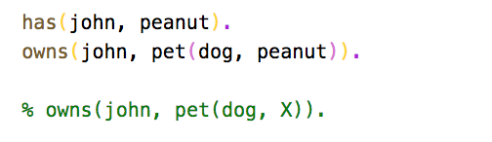
Subtypes – compound terms
Functor which an is atom
One or more arguments, which can be any terms
Notes:
Syntax: functor first, then arguments in parentheses, separated by commas
The number of arguments is called the arity

Slide 9
Relations
Specifying relationships among objects and properties of objects
Example, “John has a car”
Declaring the relationship between two objects
Example, “Does John own a car?”
Trying to find out a relationship
Example, two people (X and Y) are sisters if:
They are both female and
They both have the same parents

Slide 10
Relations
We need to be careful how we phrase things
Constraints
Conditions
Example, X and Y are sisters if:
X and Y are both female
They have the same father and
They have the same mother and
X is not the same as Y

Slide 11
Facts, rules and queries
Declare facts describing explicit relationships
Define rules defining implicit relationships
Create queries by asking about relationships
Notes:
Declare facts describing explicit relationships between objects and properties of objects – John likes chocolate, Google is a company, Jane teaches Physics
Define rules defining implicit relationships between objects and properties of objects – X is a child of Y if Y is a parent of X
Create queries by asking about relationships between objects and properties of objects – Does John like chocolate? Is Google a company?, Does Jane teach Physics?

Slide 12
Facts
John has the following cellphone number: 0271234567
In Prolog, it would be written as: cellphone_num(john, 0271234567).
cellphone_num(john, 0271234567). Is also called a predicate or clause
Notes:
Names of properties and relationships begin with a lowercase letter
Names of relationships appear as the first term
Objects appear as comma-separated arguments within the parentheses
A period “.” must end a fact

Slide 13
Facts
lectures(X, Y): lecturer X lectures paper Y
lectures(john, programming_1).
lectures(jane, programming_2).
lectures(james, programming_3).
studies(X, Y): student X studies papers Y
studies(cam, programming_1).
studies(pam, programming_2).
studies(sam, programming_3).
Facts form Prolog’s database/knowledge base

Slide 14
Rules
Facts are unit clauses and rules are non-unit clauses
Example
teaches(Lecturer, Student) :-
lectures(john, programming_1), studies (cam, programming_1).
Notes:
A lecturer will teach a student if that student studies the same course paper name on which the lecturer lectures

Slide 15
Queries
Based on facts and rules
Can ask questions based on the stored information
Example, suppose we want to know if James teaches Programming 3:
| ?- lectures(james, programming_3).
Yes
To satisfy a query, Prolog checks if a known fact is in the database
Notes:
A period “.” must end a query

Slide 16
Queries
You are choir conductor
In your choir, you have sopranos, altos, tenors, and baritones
Sopranos and tenors are upper voices (they sing melody); altos and baritones are lower voices (they sing harmony)
You wish to perform some duets, and for each, you want to choose one upper voice and one lower voice
Find all the pairs of singers who can sing a duet

Slide 17
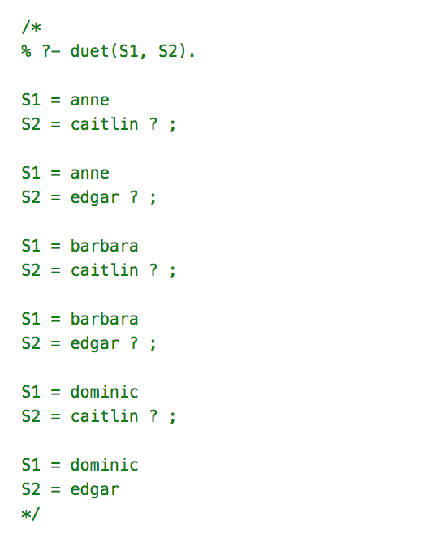
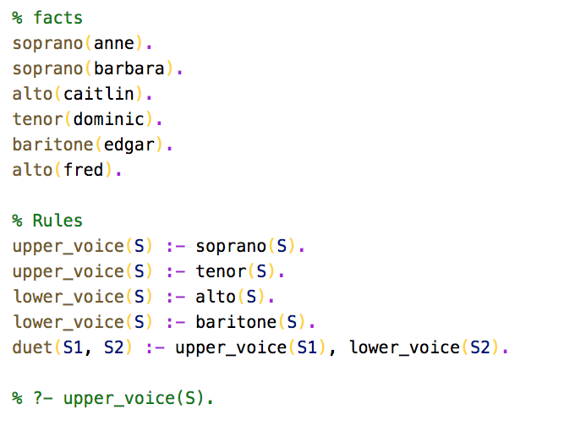
Queries

Slide 18
Syntax of a clause
“:-” means “if”. Also referred to the neck symbol
The left hand side of the neck is called the head
The right hand side of the neck is called the body
“,” stands for and/conjunction
will_graduate(Student) :- has_enough_credits(Student), hires_regalia(Student).
“;” stands for or/disjunction
can_program(Person) :- knows_csharp(Person) ; knows_java(Person).
Can also be written as:
can_program(Person) :- knows_csharp(Person).
can_program(Person) :- knows_java(Person).

Slide 19
Operators
Standard arithmetic operators
Boolean comparison
< | Less than
=< | Less than or equal to
> | Greater than
=> | Greater than or equal to
=:= | Equal in value
=\= | Not equal in value
\= | Not (re. a property)

Slide 20
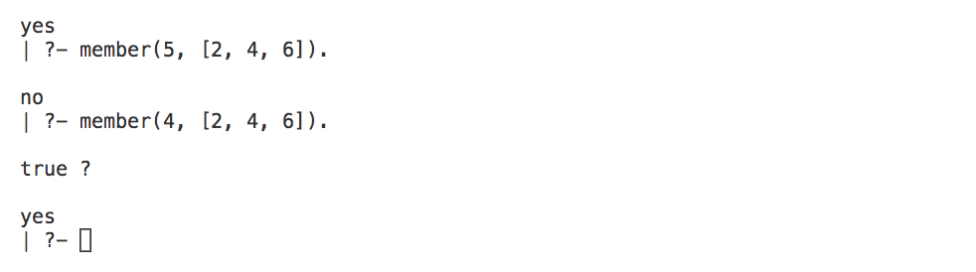
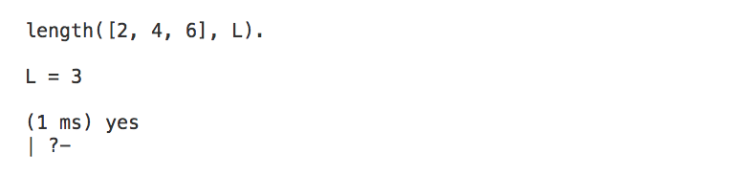
Built-in predicates
List processing
Notes:
List processing – member, reverse, delete, subtract, length

Slide 21
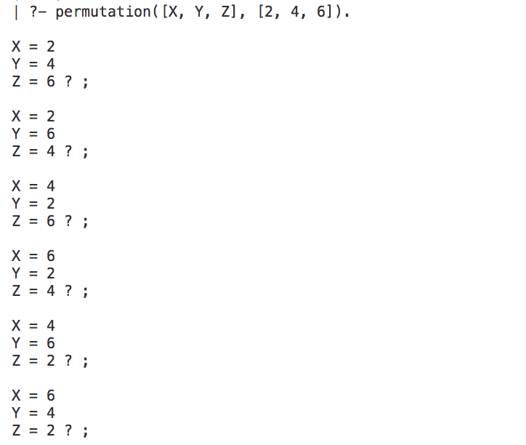
Built-in predicates

Slide 22
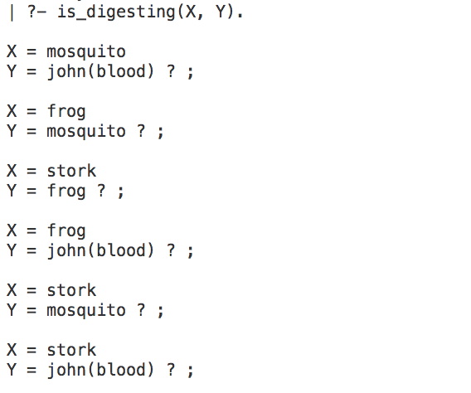
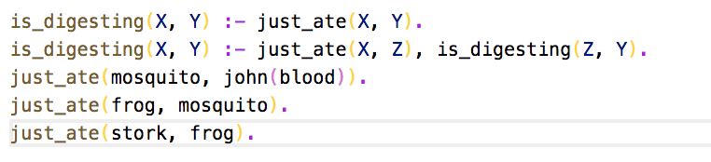
Recursion
Easy in Prolog
We don’t translate the logical relationship, we just state them

Slide 23
Recursion
The dangers of recursion – failure to terminate
Recursive relations must have (at least) two rues – base and recursive
Base must be reached – must come first in the knowledge base

Slide 24
Recursion
Apple
Amber
Eagle
Raise
V1
V2
H1
H2
Notes:
H1 – amber
H2 – eagle
V1 – apple
V2 – raise
H1 – apple
H2 – raise
V1 – amber
V2 – eagle

Slide 25
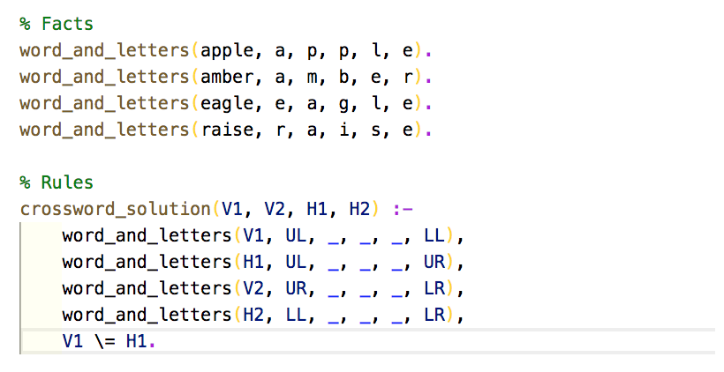
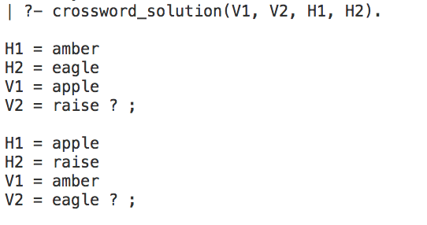
Recursion

Slide 26
Installing Prolog compiler
Find setup-gprolog-1.3.1 on I: drive.
Install
Open with the GNU Prolog shortcut.
Type your knowledge base into a text file (traditionally with file suffix .pl). Remember the full stops. Save this file on the desktop.
In the compiler, click File -> Consult and browse for your file, or type consult(“<filename>.pl”). to load your knowledge base.
Enter your queries. Remember the full stops.
Where there are multiple solutions, type ; to continue and return to break out.

